Slide 1
ASP.NET Core Introduction
Notes:
So what is .NET?

Slide 2
Additional ASP.NET Core Benefits for REST APIs
Endpoint routing - defining URLs
Support for HTTP verbs
Model binding
Content negotiation (JSON, XML, …)
Middleware / action filters
OAuth 2.0 support

Slide 3
Additional ASP.NET Core Benefits for REST APIs
Conventions
[ApiController]
ActionResult<T>
Convention definitions
Roslyn analyzers
Swagger support
SPA authentication with Identity Server

Slide 4
Security
HTTPS
OAuth 2.0
JWT token based authentication
Access grant with PKCE recommended
Identity Server 4.0
https://identityserver.io/
Third party
Auth0 - https://auth0.com/
Okta - https://developer.okta.com/
…

Slide 5
Testing
Unit testing
Integration testing
Manual testing
Tools (Postman, Insomnia, Fiddler, …)
Stress / load testing
https://loader.io/
https://artillery.io/
https://gatling.io/
http://websurge.west-wind.com/

Slide 6
Documentation
http://swagger.io/ -> https://www.openapis.org/
Swagger -> Open API Specification 3.0
API framework
Docs
Define an API
Automate API testing
Code generation
...
Swashbuckle or NSwag and Swagger UI
Notes:
API Analyzers - Microsoft.AspNetCore.Mvc.Api.Analyzers

Slide 7
Usage limiting
Limit per token
With middleware or action filter
https://github.com/stefanprodan/AspNetCoreRateLimit
Limit per Client IP
Limit per Client ID header

Slide 8
Versioning
URL, also with namespacing
/api/v2/games/
Query string
/api/games?api-version=2
Custom request header
api-version: 2
Accept header
Accept: application/json;v=2
Microsoft.AspNetCore.Mvc.Versioning
Supports all types, query string by default (?api-version=2)

Slide 9
Monitoring
Simple logging – errors, logs
Performance tracking
Usage tracking
Azure – Azure Monitor, Application Insights, Log Analytics …
ASP.NET Core Health Checks
https://github.com/Xabaril/AspNetCore.Diagnostics.HealthChecks/
Third-party monitoring services
https://newrelic.com/
https://stackify.com/
https://www.monitis.com/
https://www.runscope.com/
…

Slide 10


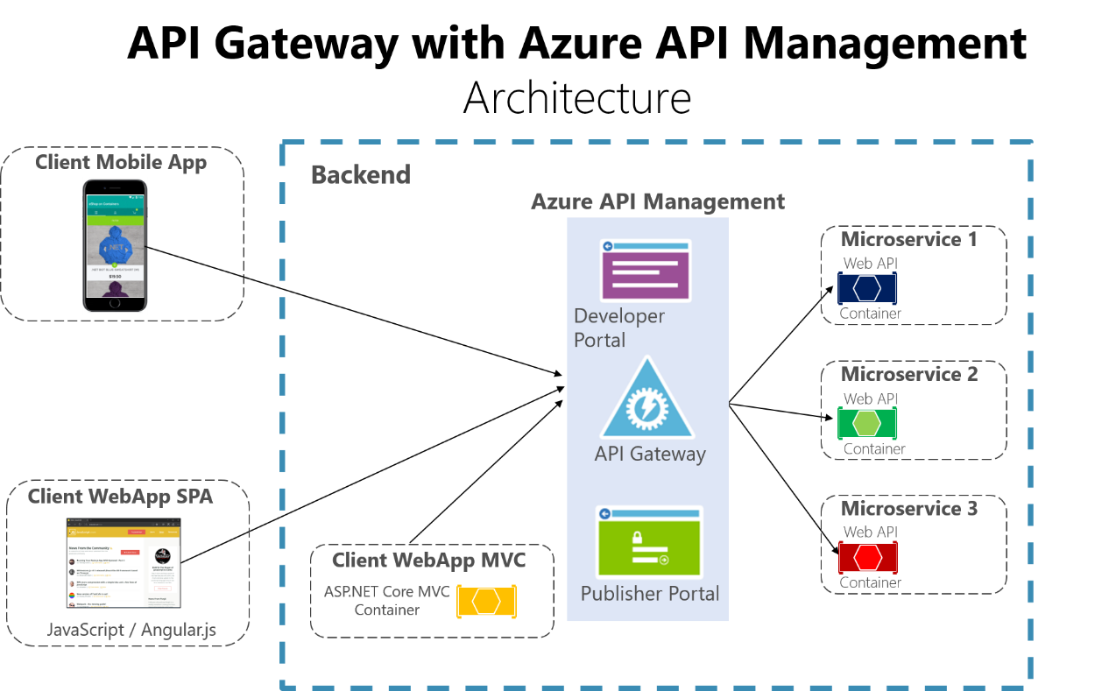
API Gateways
Features
Routing
Request Aggregation
Service Discovery with Consul & Eureka
Service Fabric
Kubernetes
WebSockets
Authentication
Authorisation
Rate Limiting
Caching
Retry policies / QoS
Load Balancing
Logging / Tracing / Correlation
Headers / Query String / Claims Transformation
Custom Middleware / Delegating Handlers
Configuration / Administration REST API
Platform / Cloud Agnostic

Slide 11
Benefits

Slide 12
ASP.NET Core Benefits
Multiplatform
Real open-source
Performance
Languages - C#, F#...
New configuration system
Easy to use with Docker

Slide 13
ASP.NET Core Benefits
Side by side execution
Joined MVC and Web API
Excellent for REST APIs
Plays great with modern web tools
Blazor - full-stack C#
Part of the .NET future
Notes:
Side by side – sandboxowanie i uruchamianie roznych wersji .net core

Slide 14
Start new project CLI

Slide 15
CLI
dotnet //check options
dotnet --version //check installed version
dotnet new webapi -h //check possiblities
dotnet new sln -n Workshop
dotnet new webapi -n Workshop.Api
dotnet sln add Workshop.Api
dotnet sln list
dotnet restore
cd Workshop.Api
dotnet run
https://localhost:5001/weatherforecast
ctrl+ c
dotnet add Workshop.Api.csproj package Swashbuckle
dotnet add Workshop.Api.csproj package Swashbuckle --version 5.6.0

Slide 16
Basics

Slide 17
Project files
.csproj SDK project file type
Lot simpler than in .NET Framework
Configure project properties and dependencies and nuget packages
Default include all file implicite exclude

Slide 18
Program.cs
Main
CreateHostBuilder
public static void Main(string[] args)
{
CreateHostBuilder(args).Build().Run();
}
public static IHostBuilder CreateHostBuilder(string[] args) =>
Host.CreateDefaultBuilder(args)
.ConfigureWebHostDefaults(webBuilder =>
{
webBuilder.UseStartup<Startup>();
});

Slide 19
Startup class
ConfigureServices
Dependency Injection configuration
services.AddTransient()
services.AddScoped()
services.AddSingleton()
Adding predefined services
services.AddMvc()
services.AddAuthentication()
Configure
Defining middleware pipeline
app.UseRouting()
app.UseMvc()
app.UseEndpoints()

Slide 20
public void ConfigureServices(IServiceCollection services)
{
services.AddControllers()
.AddNewtonsoftJson(options =>
options.SerializerSettings.ReferenceLoopHandling =
Newtonsoft.Json.ReferenceLoopHandling.Ignore);
services.AddSwaggerGen(c =>
{
c.SwaggerDoc("v1", new OpenApiInfo { Title = "My API", Version = "v1" });
});
services.AddDbContext<JohootContext>(cfg =>
{
cfg.UseSqlServer(Configuration.GetConnectionString("DefaultDbConnection"));
});
services.AddScoped<IQuizeRepository, QuizeRepository>();
services.AddScoped<IQuestionRepository, QuestionRepository>();
services.AddScoped<IAnswerRepository, AnswerRepository>();
}

Slide 21
public void ConfigureServices(IServiceCollection services)
{
services.AddControllers()
.AddNewtonsoftJson(options =>
options.SerializerSettings.ReferenceLoopHandling =
Newtonsoft.Json.ReferenceLoopHandling.Ignore);
services.AddSwaggerGen(c =>
{
c.SwaggerDoc("v1", new OpenApiInfo { Title = "My API", Version = "v1" });
});
services.AddDbContext<JohootContext>(cfg =>
{
cfg.UseSqlServer(Configuration.GetConnectionString("DefaultDbConnection"));
});
services.AddScoped<IQuizeRepository, QuizeRepository>();
services.AddScoped<IQuestionRepository, QuestionRepository>();
services.AddScoped<IAnswerRepository, AnswerRepository>();
}

Slide 22
Dependency Injection
Inversion of Control (IoC) between classes and dependencies
Lifetime - transient, scoped, singleton
Services (dependencies) registered in Startup class

Slide 23
Dependent classes
Class A uses method foo() from Class B
In other words
Class A depends from Class B
Class A
B.foo()
Class B
foo ()

Slide 24
Class lifetime dependency
Class A needs Class B object for proper functioning
so
Class A decides when Class B is instantiated
Class A
var b – new B()
b.foo()
Class B
foo ()
Notes:
Zależność czasu życia klas

Slide 25
Dependency inversion
Class A
IB ib ??
ib.foo()
Separate and invert dependencies
We introduce Interface for separating dependencies:
Loosly coupled
Both Classes depends from Interface, not on each other.
interface IB
foo ()
Class B : IB
foo ()

Slide 26
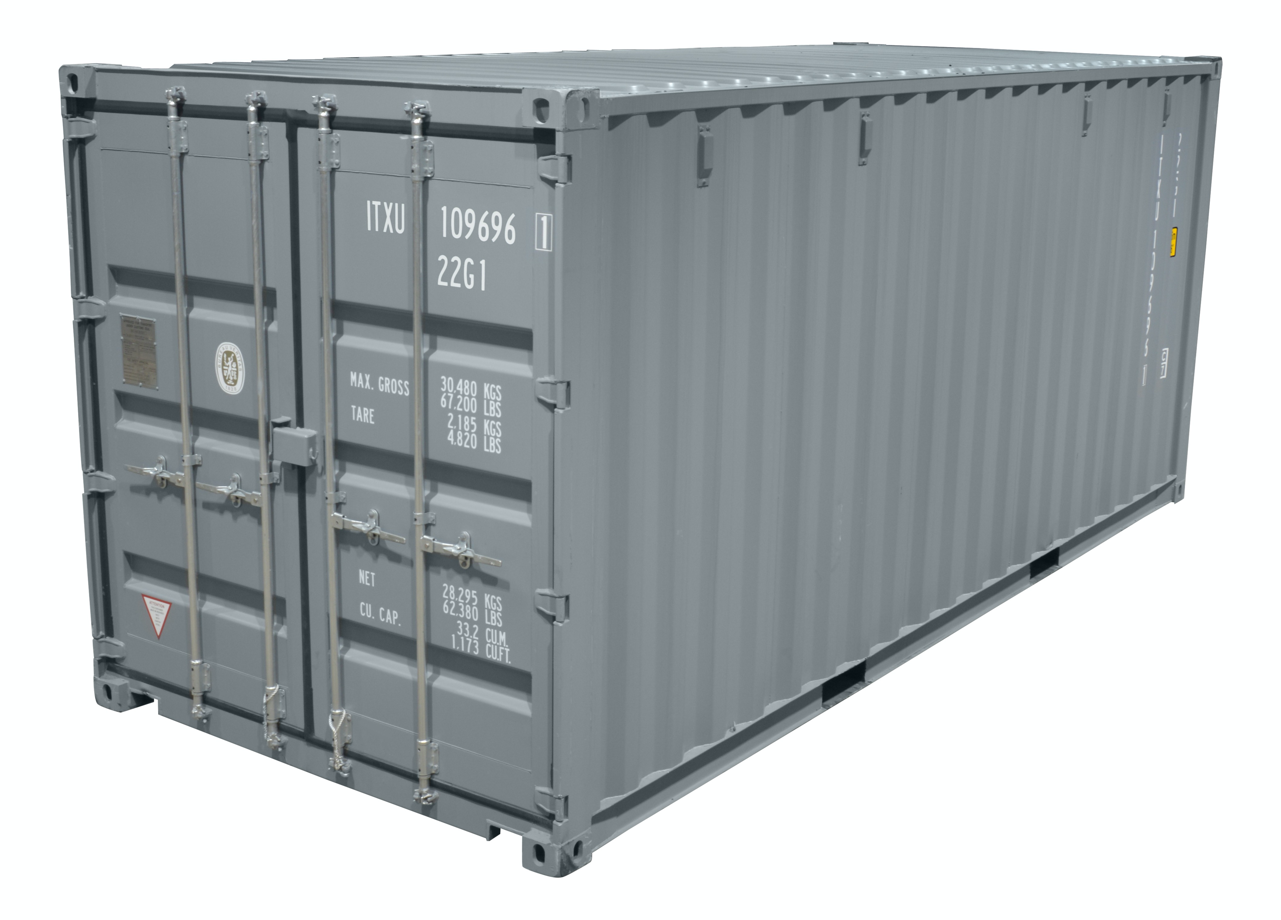
Inversion of control container
Class A
IB ib ??
ib.foo()
Wprowadzając interface rozdzielamy zależność
Loosly coupled
Obie klasy zależą od interfejsu
- Żadna klasa nie zależy od drugiej
IoC container
interface IB
foo ()
Class B : IB
foo ()
Register <IB, B>

Slide 27
Dependency injection
Class A
public A(IB ib) or [Inject] IB ib
ib.foo()
Inject instance = Dependency Injection
Wprowadzając interface rozdzielamy zależność
Loosly coupled
Obie klasy zależą od interfejsu
- Żadna klasa nie zależy od drugiej
IoC container
interface IB
foo ()
Class B : IB
foo ()
Register <IB, B>

Slide 28
Dependency injection
Class A
public A(IB ib) or [Inject] IB ib
ib.foo()
Inject instance = Dependency Injection
Wprowadzając interface rozdzielamy zależność
Loosly coupled
Obie klasy zależą od interfejsu
- Żadna klasa nie zależy od drugiej
IoC container
Transient
Scoped
Singleton
interface IB
foo ()
Class B : IB
foo ()
Register <IB, B>

Slide 29
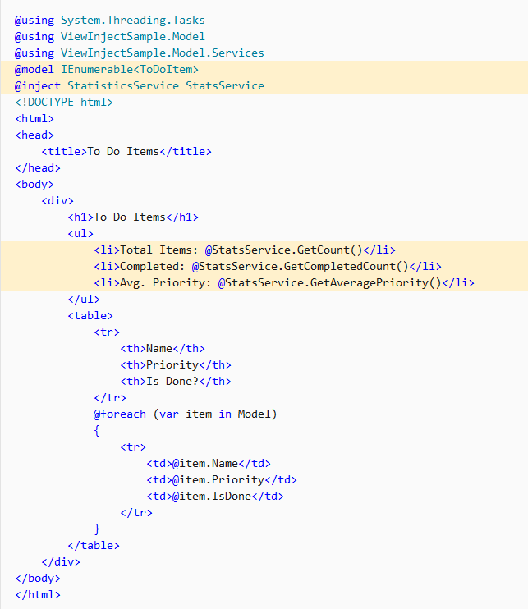
View injection

Slide 30
// This method gets called by the runtime. Use this method to configure the HTTP request pipeline.
public void Configure(IApplicationBuilder app, IWebHostEnvironment env)
{
// Enable middleware to serve generated Swagger as a JSON endpoint.
app.UseSwagger();
// Enable middleware to serve swagger-ui (HTML, JS, CSS, etc.), specifying the Swagger JSON endpoint.
app.UseSwaggerUI(c =>
{
c.SwaggerEndpoint("/swagger/v1/swagger.json", "My API V1");
});
if (env.IsDevelopment())
{
app.UseDeveloperExceptionPage();
}
app.UseHttpsRedirection();
app.UseRouting();
app.UseAuthorization();
app.UseEndpoints(endpoints =>
{
endpoints.MapControllers();
});
}

Slide 31
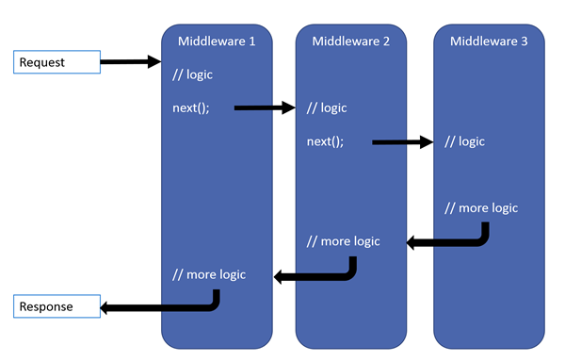
Middleware pipeline
Notes:
Image taken from the blog post by Thomas Levesque: https://thomaslevesque.com/2018/03/27/understanding-the-asp-net-core-middleware-pipeline/

Slide 32
Request Pipeline
Https Redirection
Static Files
Authorization
MVC Handler
App Code
Routing
CORS
Authentication
Endpoint

Slide 33
ASP.NET Core Request Processing
MVC Handler
Authorization Filters
Https Redirection
Static Files
Authorization
Routing
CORS
Authentication
Endpoint
Resource Filters
App Code
Model Binding
Action Filters
Controller Action execution
Exception Filters
Result Filters
Result execution

Slide 34
ASP.NET Core Request Processing
MVC Handler
HTTP Request
Https Redirection
Static Files
Authorization
Routing
CORS
Authentication
Endpoint
IIS
.NET
Core
CLR
Kestrel
Main()
Configure()
App Code
HTTP Response

Slide 35
ASP.NET Core Request Processing
HTTP
Request
IIS
.NET
Core
CLR
Kestrel
Main()
Configure()
App Code
Pipeline
HTTP
Response
NGINIX YARP

Slide 36
Kestrel configuration
public static IHostBuilder CreateHostBuilder(string[] args) =>
Host.CreateDefaultBuilder(args)
.ConfigureWebHostDefaults(webBuilder =>
{
webBuilder.ConfigureKestrel((option) =>
{
option.AllowSynchronousIO = true;
option.Limits.KeepAliveTimeout = TimeSpan.FromMinutes(2);
option.Limits.MaxConcurrentConnections = 100;
});
webBuilder.UseStartup<Startup>();
});
}

Slide 37
The Configuration System
Key-value pairs
In memory, JSON, XML, INI, environment variables
Settings are decoupled from configuration system
Optimized for dependency injection

Slide 38
Application settings
appsettings.json
Appsettings.{Environment}.json
Secret Manager
Environment Variables
Command Line Arguments

Slide 39
Configuration
Host.CreateDefaultBuilder()
IConfiguration
appsettings.json
appsettings.Development.json
appsettings.Production.json
User secrets
Environment variables
Command line arguments

Slide 40
Configuration DI ready
"JLSettings":
{
"HasCats": "true",
"CatCount": 2
}
public class JLSetOption
{
public bool HasCats { get; set; }
public int CatCount { get; set; }
}
var jlSettings = configuration.GetSection("JLSettings");
services.Configure<JLSetOption>(Configuration.GetSection("JLSettings"));
IOptions<JLSettingsOption> options,

Slide 41
Additional files
public static IHostBuilder CreateHostBuilder(string[] args) =>
Host.CreateDefaultBuilder(args)
.ConfigureAppConfiguration((cnt) =>
cnt.AddJsonFile("jl1.json"))
.ConfigureAppConfiguration((cnt) =>
cnt.AddJsonFile("jl2.json"))
.ConfigureWebHostDefaults(webBuilder =>
{
webBuilder.UseStartup<Startup>();
});
Notes:
– co jak sa tak samo nazwane sekcje w dwoch plikach -> ostatnia rejestracja wygrywa, choc sa oba w histori – da sie do tego dostac

Slide 42
Routing
Mapping URLs to code
Conventions and attribute based
Works for any server type
app.UseRouting()
app.UseEndpoints(...)
[ApiController]
[Route("[controller]")]
public class WeatherForecastController : ControllerBase

Slide 43
Static files
wwwroot folder
app.UseStaticFiles()
app.UseDirectoryBrowser()
app.UseDefaultFiles()
app.UseFileServer()

Slide 44
Basic Logging
ILogger, ILogger<T>
_logger.LogInformation()
_logger.LogDebug()
_logger.LogError()
Console logger
Debug logger

Slide 45
MVC

Slide 46

MVC
Model View Controller

Slide 47
Controllers
Inherit Controller class (or not)
Have action methods
Endpoints with URLs
Triggered with HTTP verbs
GET, POST, PUT, DELETE…
Can have input parameters
processed with model binding
Can return
views or
raw data using content negotiation

Slide 48
Models & View Models
Models
Domain data
Can be loaded from DB
Can have validation
View Models
Or input models, or display models, or DTOs…
Subset of data designed according to the view needs
Subset of data that user will send in request (input model)
Input models should have validation

Slide 49
Razor
.cshtml files
Syntax for embedding server-side code into web pages
Razor markup + C# + HTML

Slide 50
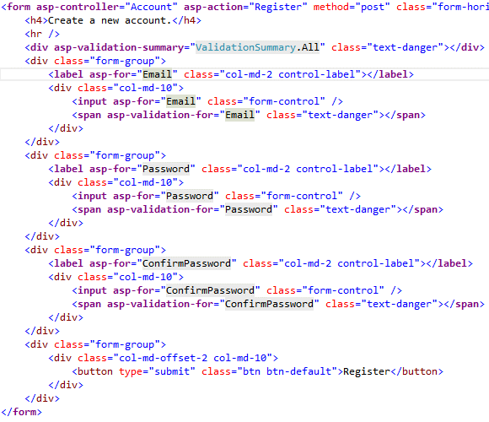
Tag Helpers
Enable server-side code to participate in creating and rendering of HTML elements
<label asp-for=“Product.Name”></label>
<label for=“Product_Name”></label>
Nicer syntax comparing to HTML helpers

Slide 51
Web Components
Doesn’t use model binding
Can have parameters and business logic
Has a C# class and a view
For reusable parts of the view:
Login panel
Shopping cart
Tag cloud
Dynamic menus
…
<wc:my-component parameter1=“value1”> </wc:my-component>

Slide 52
Web API

Slide 53
Similar to MVC
Same controllers
Same models
Similar View Models
No Views - raw data returned

Slide 54
Controllers
Inherit ControllerBase class
[ApiController] attribute
Have action methods
Endpoints with URLs
Triggered with HTTP verbs
GET, POST, PUT, DELETE…
Can have input parameters
processed with model binding
Can return
views or
raw data using content negotiation

Slide 55
Models & View Models
Models
Domain data
Can be loaded from DB
Can have validation
View Models
Or input models, or display models, or DTOs…
Subset of data designed according to the view needs
Subset of data that user will send in request (input model)
Input models should have validation
Notes:
Modele prawdopowobnie beda outsourced do innych projektow

Slide 56
Conventions
[ApiController] attribute
ActionResult<T>
API convention classes
API analyzers
Swagger / Open API specification

Slide 57
Clients
SPA clients (Aurelia, Angular, React, Vue…)
Mobile clients (Android, iOS…)
.NET Clients
HttpClient
HttpClientFactory
Swagger code generation
Notes:
Why it’s a good idea to use HttpClientFactory: https://docs.microsoft.com/en-us/dotnet/standard/microservices-architecture/implement-resilient-applications/use-httpclientfactory-to-implement-resilient-http-requests
NSwag: https://github.com/RicoSuter/Nswag

Slide 58
Data access & auth

Slide 59
Entity Framework Core
ORM - Object-Relational Mapper
Mapping models to db
LINQ for queries (or raw SQL)
Multiple databases supported
SQL Server, SQLite, InMemory
CosmosDB
PostgreSQL, MySQL, Maria
Oracle
…
DB versioning and migrations for code first or SSDT
Notes:
dbpack

Slide 60
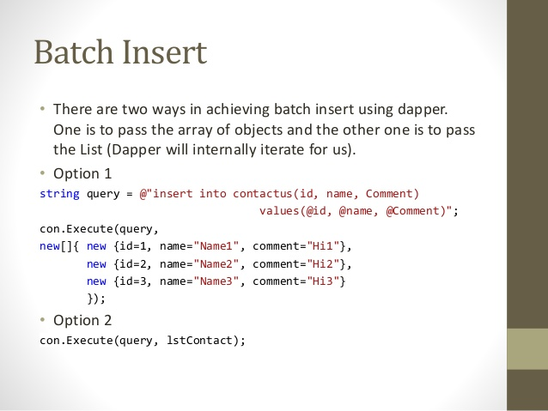
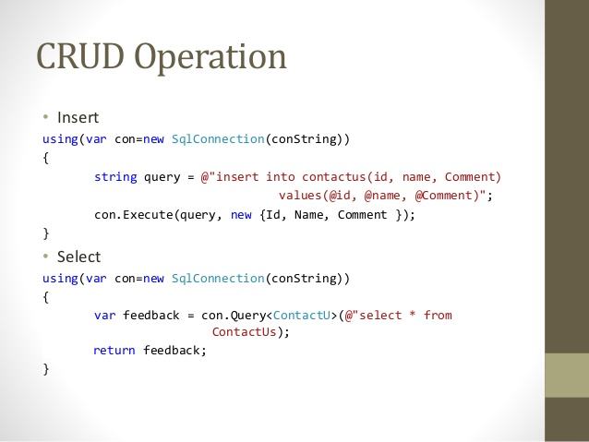
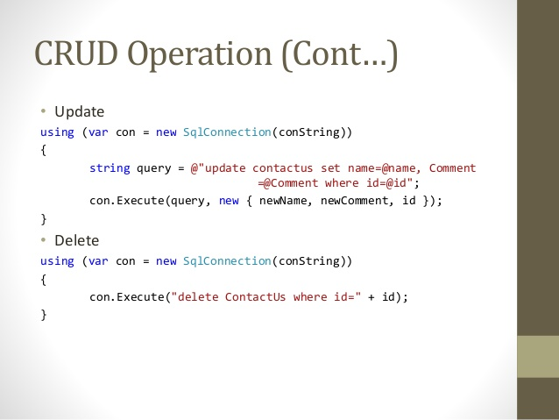
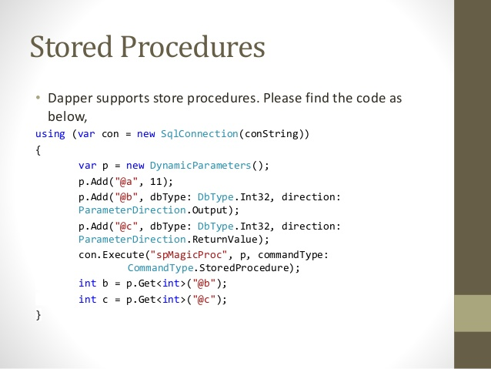
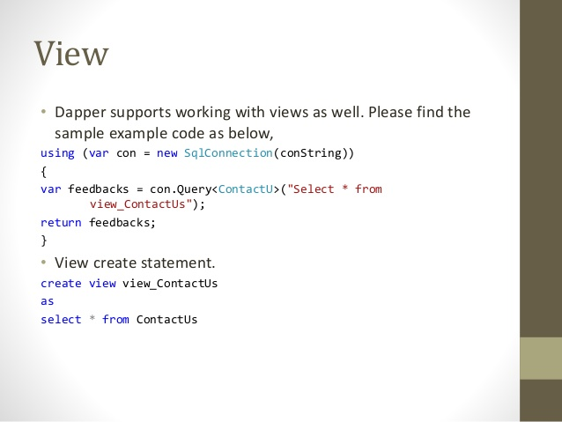
Dapper
Dapper.NET is an Open-Source, Micro ORM developed by the developers of Stack Overflow
Ultra fast – performance is a key feature
Pure SQL
Maps query result to list of POCOs or dynamics
Support for Stored Procedures views and transactions
Single file with less then 700 lines of code (including comments)
Queries caching
https://github.com/StackExchange/Dapper

Slide 61
Dapper

Slide 62
Dapper

Slide 63
Dapper – Batch insert

Slide 64
Dapper – Stored procedures

Slide 65
Authentication & Authorization
Authentication middleware
Authorization middleware
[Authorize] filters
OAuth 2.0 & OpenID Connect

Slide 66
ASP.NET Core Identity
Local authentication
username and password
OpenID authentication
Google, Microsoft, Twitter, Facebook…
Federated authentication
Active Directory, Azure AD, Windows authentication…
Full solution
Views and logic for user registration and authentication
Scaffolding

Slide 67
Identity Server
Advanced scenarios
OAuth 2.0 and OpenID Connect server

Slide 68
Learn
https://docs.microsoft.com/en-us/learn/modules/build-web-api-net-core/
https://docs.microsoft.com/en-us/learn/modules/create-razor-pages-aspnet-core/
https://docs.microsoft.com/en-us/learn/modules/persist-data-ef-core/
https://docs.microsoft.com/en-us/learn/modules/improve-api-developer-experience-with-swagger/
https://docs.microsoft.com/en-us/learn/modules/optimize-your-web-apps-with-redis/
https://docs.microsoft.com/en-us/learn/modules/microservices-aspnet-core/

Slide 69
Production-ready APIs?

Slide 70
Best practices
IActionResult, ActionResult<T>
View Models
Model / input validation
Exception handling
Logging
Paging

Slide 71
Thanks! Questions?

